Slide 1

INTRUSION DETECTION SYSTEM
FOR CONTROLLER AREA NETWORK
Presented by : Oussema Ben Ayech
Supervised by : Dr. Sofien Dridi

Slide 2
TABLE OF CONTENT
01
05
Introduction
Statistics
02
06
vulnerability
Conclusion
03
Problems
04
Solutions

Slide 3
.1 INTRODUCTION

Slide 4

INTRODUCTION
ARTICLE SUMMARY :
Intrusion detection system for controller area network - paper
The study explores rising cybersecurity threats in vehicles, focusing on the Controller Area Network (CAN). CAN's original focus on speed and reliability omitted security, creating vulnerabilities. The proposed intrusion detection system, featuring a Long Short-Term Memory (LSTM) network and decision engine, identifies anomalies in real-time. Real-world testing confirms the system secures CAN networks efficiently, emphasizing the need for better security in connected vehicles.

Slide 5

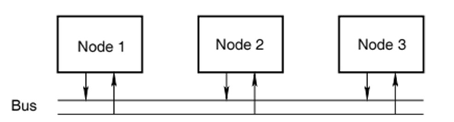
WHAT IS CAN ?
The Controller Area Network (CAN) is a common serial bus system that links electronic control units (ECUs) within vehicles, facilitating communication between subsystems like engine and transmission control. CAN enables coordinated functions vehicle-wide. CAN with flexible data-rate (CAN FD) is the latest communication standard that provides high data rates. Classical CAN was introduced in 1986 and implemented in 1988 and CAN FD was launched in 2012 and internationally standardized in 2015 in ISO 11898-1.

Slide 6
.2 VULNERABILITY

Slide 7

vulnerability
Miller and Valasek famously demonstrated a successful car hack at DEF CON, where they manipulated the vehicle's speed displayed on the speedometer by altering CAN messages, leading to a dangerous driving situation.
( something u hear only in movies )
CVE : N/A

Slide 8



This attack target many I/O peripherial

Slide 9
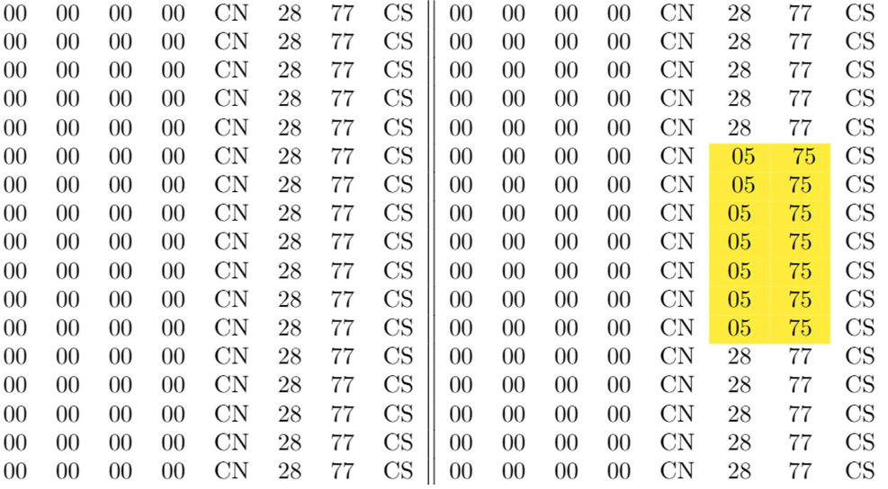
EXPLOIT

Slide 10
COMMUN REASONS WHY THIS ATTACK CAN BE PERFORMED ON THE CAN PROTOCOL :
Lack of Authentication: There is no source or message authentication, making the CAN network vulnerable to integrity violations and replay attacks.
Broadcast Communication: All nodes broadcast their messages on the CAN, allowing malicious nodes to sniff all traffic.
Low-Latency Requirement: Security mechanisms may add significantly to the delay due to the requirement of messages being sent and received in real-time.

Slide 11
.3 PROBLEMS

Slide 12




PROBLEMS
Thynk Unlimited
CAN Vulnerabilities and Mitigation Challenges:
Lack of Authentication: There is no source or message authentication, making the CAN network vulnerable to integrity violations and replay attacks.
Limited Payload Size: Implementing Message Authentication Codes (MACs) on CAN faces limitations due to the small CAN frame size, potentially compromising the strength of the MAC or the amount of data transmitted.
Replay Attacks: The observation that most ECUs send similar messages with minor changes makes CAN susceptible to replay attacks, even with authentication attempts.
Latency: Adding authentication procedures increases latency, as noted in the paper.

Slide 13
SOLUTIONS

Slide 14
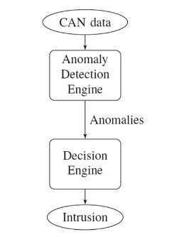
SOLUTIONS
The article proposes an intrusion detection system (IDS) featuring:
LSTM Network: Detects anomalies in CAN frame sequences by identifying suspicious temporal patterns.
Decision Engine: Uses contextual parameters and outputs from anomaly detection functions to decide if an intrusion is occurring, improving accuracy.
helps resolve conflicting information and improve the overall accuracy of the IDS.

Slide 15
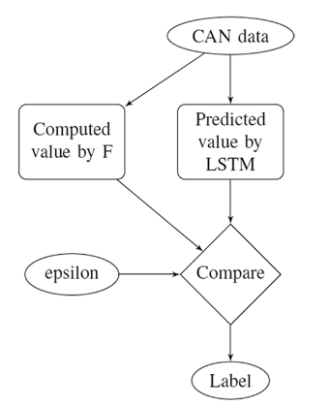
Proposed solution visualized
The diagram shows a process where CAN data is analyzed by a function (F) and an LSTM. Their outputs, along with a threshold (epsilon), are compared to label the data as normal or anomalous. The LSTM learns patterns, while function F provides a calculated value. The comparison stage determines the final label.

Slide 16
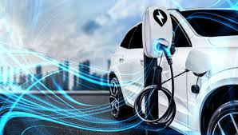
FUTURE OF THE ATTACK SURFACE THAT TARGETS ELECTRICAL-VEHICULS :
1. Vehicle-to-Grid (V2G) Exploits
2. OCPP (Open Charge Point Protocol) Vulnerabilities
3. Malware Injection via Charging Stations
4. Key Fob/Phone-as-a-Key Attacks

Slide 17

1. VEHICLE-TO-GRID (V2G) EXPLOITS
"Cybersecurity in Vehicle-to-Grid (V2G) Systems: A Systematic Review"
This paper provides a comprehensive review of V2G cybersecurity, highlighting vulnerabilities such as insecure communication channels, denial-of-service (DoS), spoofing, data manipulation, and botnet attacks targeting EVs, charging stations, and the grid1.
Reference: arXiv:2503.15730v1 (2025)
"Local Power Grids at Risk – An Experimental and Simulation-based Analysis of Attacks on Vehicle-To-Grid Communication"
This study experimentally analyzes attacks on V2G communication, including manipulation of grid stability and malicious control of EV charging/discharging4.

Slide 18
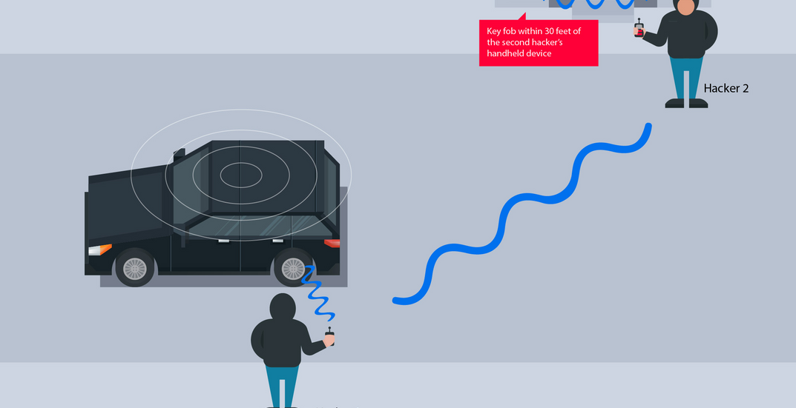
4. KEY FOB/PHONE-AS-A-KEY ATTACKS
The review identifies insecure authentication mechanisms, including weak key management and vulnerabilities in wireless communication (such as key fobs and phone-as-a-key systems), as attack vectors for unauthorized access to EVs and charging systems1.
Reference: arXiv:2503.15730v1 (2025)
For a focused review of each attack type, see:
arXiv:2503.15730v1 – "Cybersecurity in Vehicle-to-Grid (V2G) Systems: A Systematic Review"1
ACM Digital Library – "Local Power Grids at Risk – An Experimental and Simulation-based Analysis of Attacks on Vehicle-To-Grid Communication"4
These papers offer detailed discussions of the cybersecurity landscape and specific vulnerabilities for electric vehicles and their charging infrastructure.

Slide 19
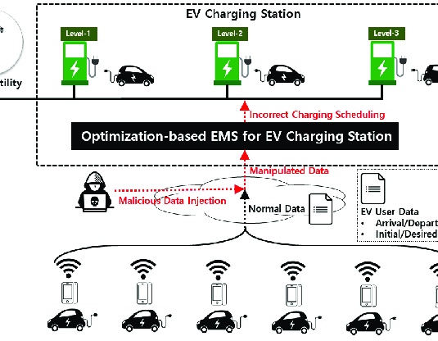
3. Malware Injection via Charging Stations
The same systematic review discusses malware and malicious injection threats to both EVs and charging stations, emphasizing the risk of malware spreading through insecure or compromised charging infrastructure1.

Slide 20
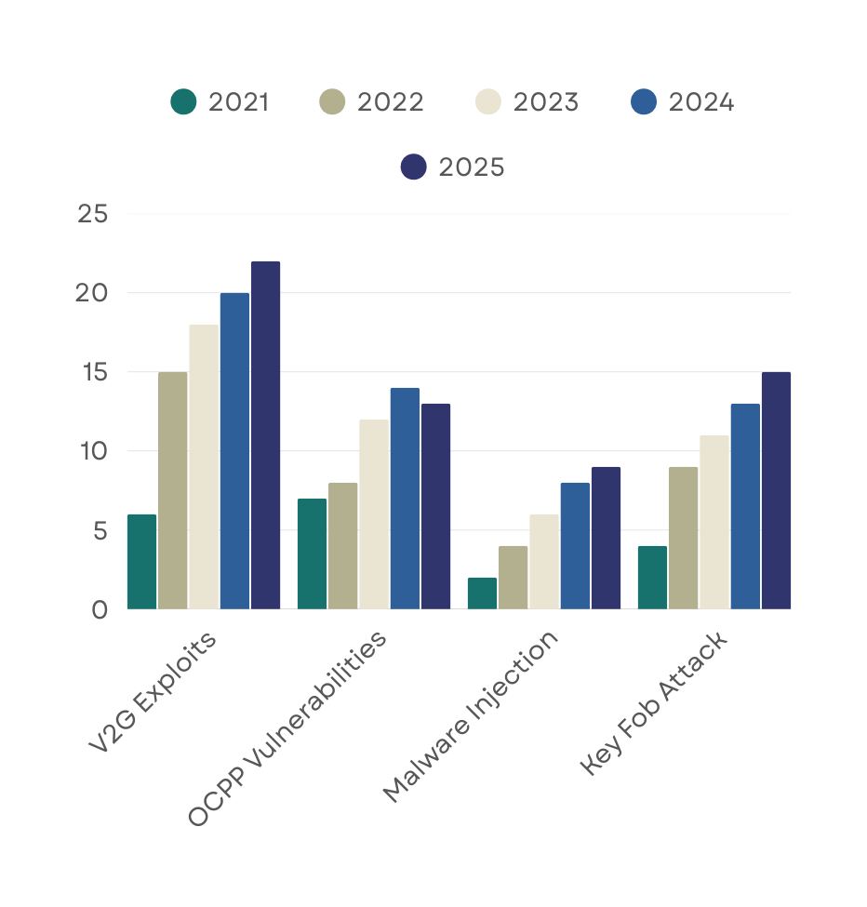
STATISTIC
Incident Volume and Growth
From 2021 to 2025, attacks targeting electric vehicles have shown an increasing trend. Key Fob/Phone-as-a-Key Attacks (Series 1) rose significantly from 4 incidents in 2021 to 15 in 2025. OCPP Vulnerabilities (Series 2) peaked at 7 incidents in 2024, ending at 6 incidents in 2025. Malware Injection attacks (Series 3) remained relatively low but grew steadily, with incidents increasing from 1 in 2021 to 4 in 2025.

Slide 21
Thynk Unlimited
CONCLUSION
In summary, this research project provided an opportunity to investigate cybersecurity within Controller Area Networks (CANs). By examining research papers and recent innovations, we've pinpointed advancements, challenges, and gaps in securing these networks. The presentation on April 22th, 2025, will share these insights, fostering deeper comprehension and refining research and communication skills for addressing cybersecurity challenges in modern vehicles.

Slide 22
THANK YOU
FOR YOUR NICE ATTENTION

Slide 23
REFERENCES
https://cybersecurity.springeropen.com/articles/10.1186/s42400-023-00195-4
https://arxiv.org/pdf/2503.15730

